Slide 1

Forecasting Short Term Solar Energy Production
by
Manasi Mahish

Slide 2
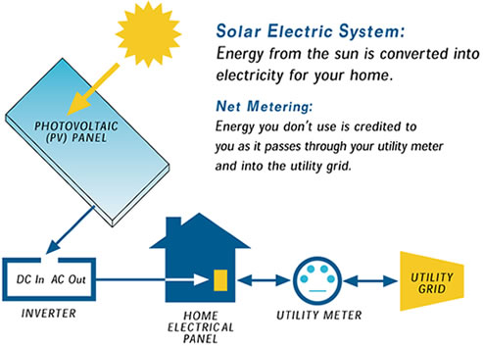
Solar energy production: current situation
Advantage
renewable
readily available
low carbon footprint
Challenge
dependent on weather variables
difficult to accurately predict time ahead
may cause the utilities to purchase emergency power from neighboring utilities while over-predicting
may cause excess generation of power while under-predicting
Solution
forecast solar energy production as accurate as possible using machine learning algorithms

Slide 3
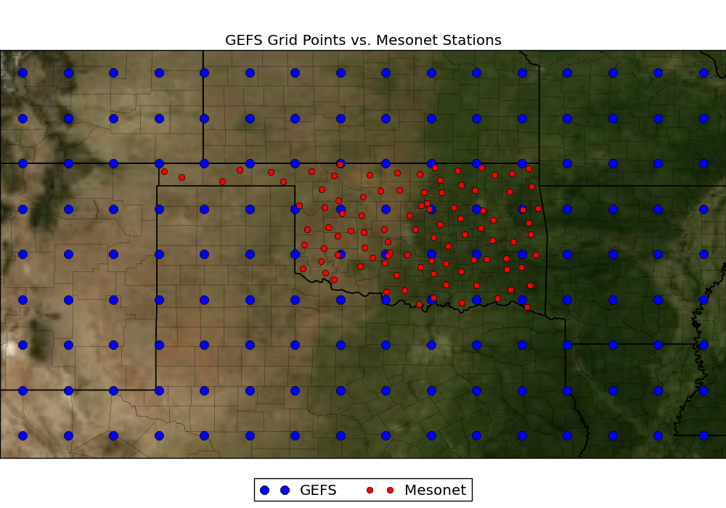
Scope of the work
Forecast solar energy production at 98 Mesonet stations (red)
Model: machine learning algorithm- linear regression, gradient boosting, random forest
Input data: Numerical weather prediction (NWP) model data from NOAA/ESRL Global Ensemble Forecasting System (GEFS) for 1° apart grid points (blue)
Target metrics: Normalized root mean square error (NRMSE) as 0.05 and correlation coefficient as 0.9 between predicted and actual solar energy production

Slide 4
Data description
Data structure: 5113 (days) x 11 (model ensemble) x 5 (times /day) x 9 (latitude) x 16 (longitude)
Input data
Radiative flux: downward long-wave radiative flux at surface (DLWRFS), downward short-wave radiative flux at surface (DSWRFS), upward long-wave radiation at surface (ULWRFS), upward short-wave radiation at surface (USWRFS), upward long-wave radiation at top of the atmosphere (ULWRF)
Temperature: maximum temperature at 2 m above ground (MaxT), minimum temperature at 2 m above ground (MinT), current temperature at 2 m above ground, temperature of surface (T)
Other variables: air pressure at mean sea level (Pr), 3-Hour accumulated precipitation at surface (Precip), precipitable water over entire depth of atmosphere (PW), specific humidity at 2 m above ground (H), total cloud cover over entire depth of atmosphere (TCC), total column-integrated condensate over entire atmosphere (TC)
Target variable
Solar energy production
Training data: 1997 – 2007 weather (input) and solar energy (output) data
Model prediction: 2008 – 2012 solar energy production based on weather data

Slide 5
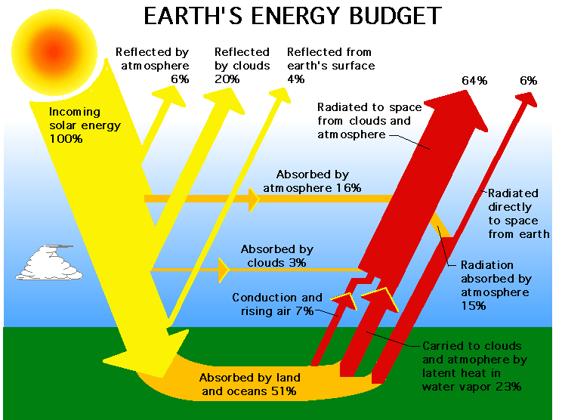
Exploratory analysis: radiative flux
Radiative Flux: Amount of solar energy radiated through a given area
Incoming radiation ~ shortwave, high energy, emitted from very hot sun
Upward radiation ~ longwave, low in energy, re-emitted by much cooler earth
A small fraction goes back to space
https://kisialevelgeography.wordpress.com/as-atmosphere-weather/

Slide 6
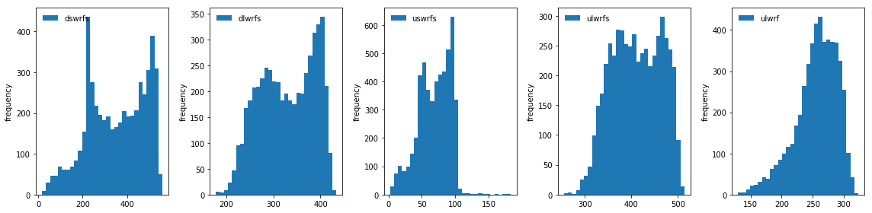
Frequency distribution: radiative flux
Downward flux with 2 distinct peaks - summer and winter
Downward shortwave - highest magnitude
Upward shortwave– lowest magnitude
Upward flux – longwave primarily

Slide 7
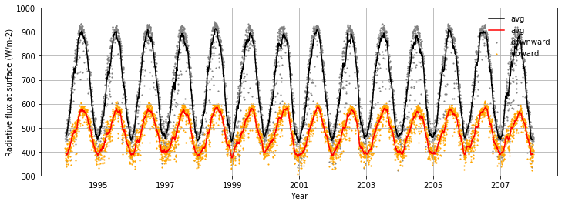
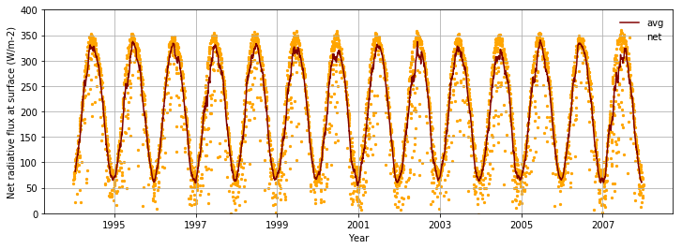
Time series analysis: radiative flux
Downward radiation: shortwave (mainly) + longwave
Upward radiation: shortwave + longwave (mainly)
Net radiation at surface: downward – upward
Seasonality evident in downward, upward and net radiation at surface
Seasonality caused by tilt of earth (primarily ) + various weather elements

Slide 8
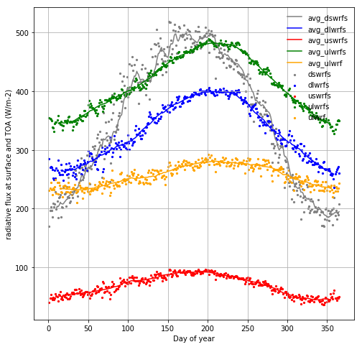
Seasonal variation in radiative flux
Seasonality in downward shortwave is greatest
A change of 200 to 500 units between winter low to summer high
All radiations high in summer and lower in winter
There is time lag between the peaks of various radiations
Re-emitted long wave peaks later than the shortwave

Slide 9
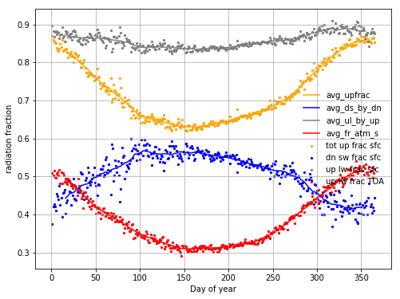
Seasonal variation in radiation fraction
The fraction of energy re-emitted from earth surface (orange) is less in summer
Downward shortwave radiation as fraction of total downward radiation (blue) is higher in spring and summer
Upward longwave radiation as fraction of total upward radiation (gray)> 80%
Upward longwave radiation at TOA as a fraction of total downard radiation at surface (red) is less in summer months

Slide 10
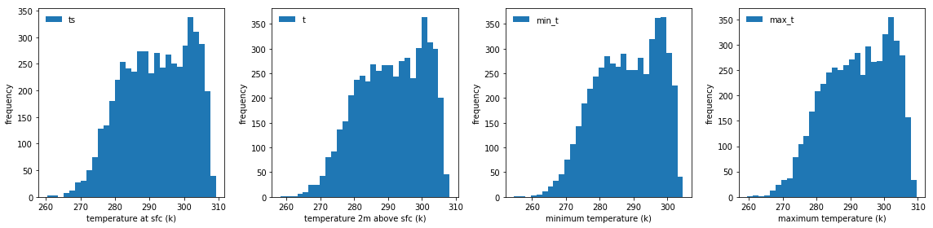
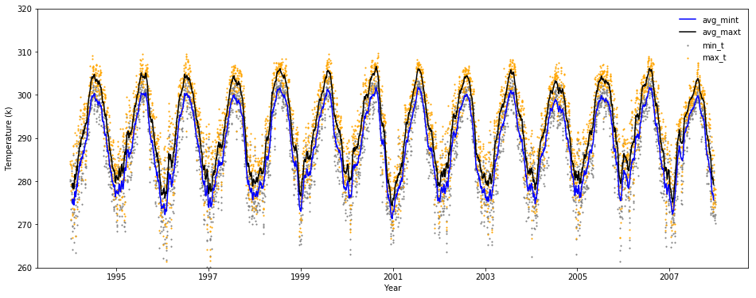
Frequency & time series analysis: temperature
Distribution similar for all temperature measurements
Temperature closely tied to the amount of radiation at surface
Seasonality evident with high in summer and low in winter

Slide 11
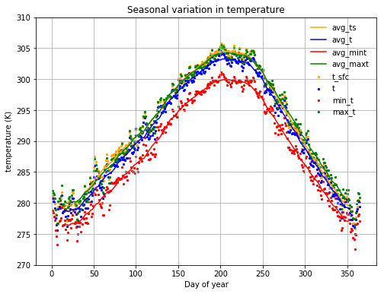
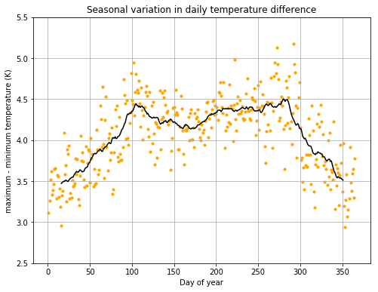
Seasonal variation in temperature
Seasonality evident in temperature
Temperature at surface (orange) higher than temperature above surface (blue) due to higher temperature gradient near surface
Difference in daily maximum and minimum temperature higher during spring and fall, and lower in winter

Slide 12
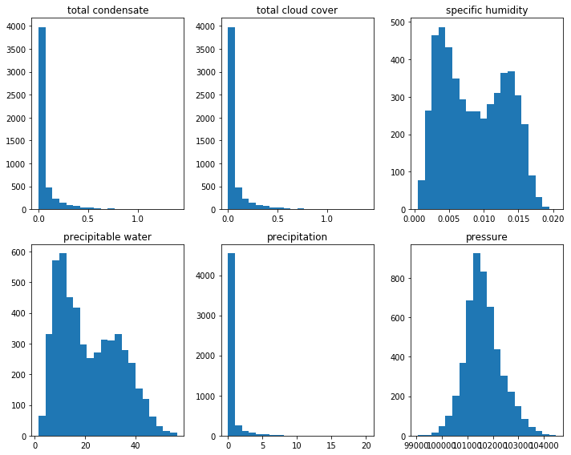
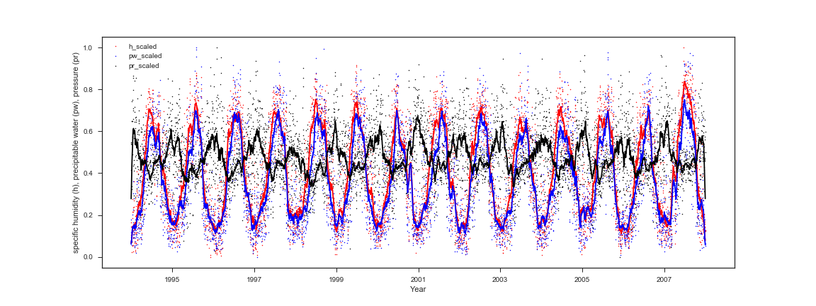
Frequency & time series analysis: other variables
Total condensate, cloud cover and precipitation : most data near first bin
Specific humidity and precipitable water with bimodal distribution, similar to temperature, large number of humid and dry days
Pressure more normally distributed
Seasonality in specific humidity, precipitable water and pressure
Specific humidity and precipitable water high in summer low in winter
Pressure high in winter and low in summer

Slide 13
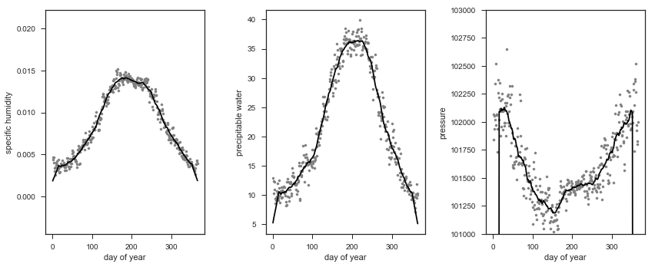
Seasonal variation in humidity and pressure
Seasonality evident in specific humidity, precipitable water and pressure – specific humidity, and precipitable water high in summer and low in winter, pressure high in summer and low in winter

Slide 14
Correlation analysis with the target variable
Variable | Correlation coefficient with target | Variable | Correlation coefficient with target
Target | 1.000 | H | 0.432
DSWRFS | 0.888 | DLWRFS | 0.351
USWRFS | 0.843 | PW | 0.254
ULWRF | 0.660 | Pr | -0.227
TS | 0.644 | Precip | -0.309
ULWRFS | 0.633 | TC | -0.487
MaxT | 0.628 | TCC | -0.487
T | 0.627 | MinT | 0.580
The radiations in general strongly correlated with solar energy
Downward shortwave radiation primary source of energy - highest correlation with solar energy production
Pressure having minimum / no effect on solar energy
Total cloud cover (TCC), total condensate (TC), precipitation negatively affect solar energy; more atmospheric moisture, more absorption of radiation by the atmosphere, less energy reaching surface

Slide 15
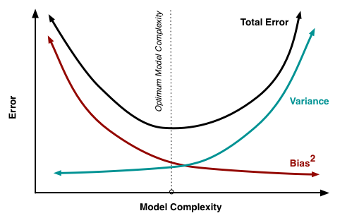
Model prediction: choosing the right model
Simple model
Underfitted dataset
High bias
Low variance
Generalized
Complex model
Overfitted dataset
Low bias
High variance
Not generalized
Flexible
Objective: build a model with optimum model complexity

Slide 16
Machine learning algorithm
Linear regression
Simple model
Assumed linear relations between features and target variable
Bias high, variance low
Gradient boosting
Built on weak regressors
Sequential process
Following regressor learns from previous regressor’s mistake
Random forest
Decision trees prone to overfitting
Parallel process
Higher number of decision trees employed to process re-sampled data
Relies on voting to average out overfitting
Computationally expensive

Slide 17
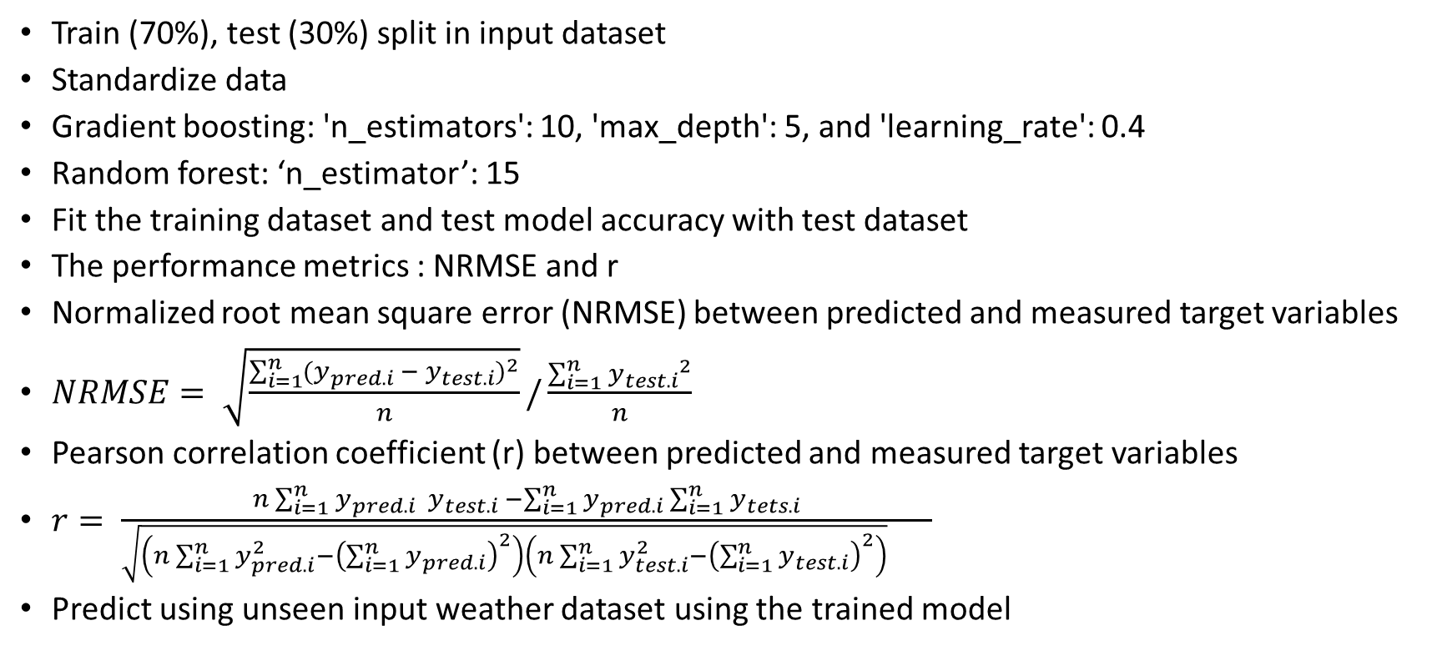
Modeling steps
Train (70%), test (30%) split in input dataset
Standardize data
Gradient boosting: 'n_estimators': 10, 'max_depth': 5, and 'learning_rate': 0.4
Random forest: ‘n_estimator’: 15
Fit the training dataset and test model accuracy with test dataset
The performance metrics : NRMSE and r
Normalized root mean square error (NRMSE) between predicted and measured target variables
$NRMSE= \sqrt{\frac{\sum_{i=1}^{n}{{(y_{pred.i} − y_{test.i})}^{2}}}{n}}/\frac{\sum_{i=1}^{n}{{y_{test.i}}^{2}}}{n}$
Pearson correlation coefficient (r) between predicted and measured target variables
$r= \frac{n\sum_{i=1}^{n}{y_{pred.i}{ y}_{test.i}} −\sum_{i=1}^{n}{y_{pred.i}\sum_{i=1}^{n}{y_{tets.i}}}}{\sqrt{\left(n\sum_{i=1}^{n}{y_{pred.i}^{2}}−{\left(\sum_{i=1}^{n}{y_{pred.i}}\right)}^{2}\right)\left(n\sum_{i=1}^{n}{y_{test.i}^{2}}−{\left(\sum_{i=1}^{n}{y_{test.i}}\right)}^{2}\right)} }$
Predict using unseen input weather dataset using the trained model

Slide 18
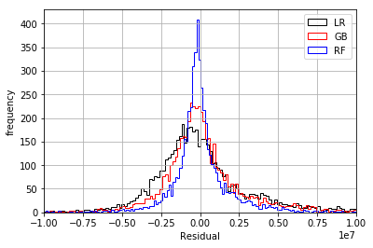
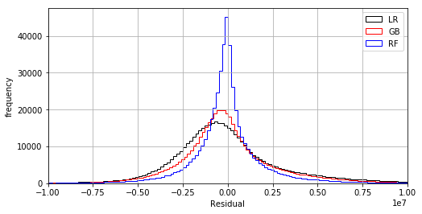
Residual distribution of ML algorithms
ACME station
All 98 stations

Slide 19
Comparisons of ML algorithms
Machine learning | Error components |  | Parameters | NRMSE / Correlation coefficient
 |  |  |  | Station 'ACME' |  |  |  | All stations
 | bias | variance |  | All features |  | Radiative flux only |  | All features
 |  |  |  | NRMSE | Corrcoef | NRMSE | Corrcoef | NRMSE | Corrcoef
Linear regression | high | low | default | 0.191 | 0.912 | 0.2 | 0.901 | 0.2 | 0.909
Gradient boosting | high | low | n_estimator = 10 | 0.194 | 0.934 | 0.194 | 0.902 | 0.204 | 0.932
Random forest | low | high | n_estimator = 15 | 0.19 | 0.967 | 0.201 | 0.958 | 0.206 | 0.961

Slide 20
Conclusion
The target NRMSE (0.05) was not achieved but the target correlation coefficient (0.9) was obtained in all cases
Solar energy was predicted appropriately using weather inputs
Radiative data alone effectively predicts solar energy with some error margin
Similar accuracy achieved using 3 ML algorithms
Linear regression is the simplest and chosen model for solar energy prediction

Slide 21


